Slide 1
UKRAINE'S EXPORT POTENTIAL
State Institution «Export Promotion
Office of Ukraine»

Slide 2




Summary
Ukraine Export
Potential
Export Promotion
Office of Ukraine (EPO) Activities
Sourcing Services
by EPO

Slide 3




Key
information
Largest country within Europe - 603,500 square km
42 million
+ 20 mln diaspora worldwide
World player
in agriculture industry, developed energy, metallurgy, chemicals, manufacturing, massive innovative industrial base, booming IT and
high-tech sector
Trade openness: Among the top countries open for trade with 99%
(trade as % of GDP)
Ukraine’s export potential

Slide 4
Key figures
17 FTAs
$ 25 bln
with 46 countries
Of goods and services exported to EU in 2019
DCFTA with EU, FTAs with CIS, EFTA, Canada, Georgia, Macedonia, Montenegro, Israel. On-going negotiations with Turkey
51.5%
41.5%
UA export growth to the EU since signing of DCFTA (Jan 2016)
Share of UA export of goods
and services to the EU
Ukraine’s export potential

Slide 5






Priority Sectors
of Ukraine
Information and communication technology (ICT)
Manufacturing
of spare parts and components for aerospace and airplane industries
Creative Industries (incl. Apparel, Footwear & Furniture)
Mechanical engineering/
machinery
Technical servicing and repair
of air vehicles
Food and
processing
industry
Ukraine’s export potential

Slide 6

IT sector
3rd largest export service industry - 4 % of GDP
$4.5B revenue in 2018
1600+ software development companies
2300+ tech companies
185.000+ IT specialists,
Every year more than 36,000 students graduate from local universities with degrees in IT-related fields
Ukraine’s export potential

Slide 7
IT industry is growing
at 26% rate
Average software developer salary varying between $2,500 and $4,000 per month
(excluding taxes and social contributions). (up to 4 times chipper than in North America or Western Europe)
2,000+ Up-and-Coming Startups: Grammarly, Readdle, Jooble, DepositPhotos, GitLab, TemplateMonster, PetCube, Viewdle, CleanMyMac and others
100+ Global companies have software R&D facilities in Ukraine:
UBISoft, Wargaming, Boeing, Skype, eBay, Bosch, Siemens, Samsung, Ericsson, Oracle, Cisco, SoftServe, Huawei, Mellanox Technologies, NetCracker, Procter & Gamble, Bioclinica, WIX
English: 81% of IT professionals has intermediate and upper English language level
Ukraine’s export potential

Slide 8




IT Export Opportunities
Product development
R&D facilities
Global giants like
General Electric
Samsung
Boeing
Deutsche Bank
Canadian Tire
tech start-ups
and even American hospitals
Game
development
IT-outsourcing
Software development
(e-Commerce, enterprise, finance, education, healthcare, travel tech, telecom)
turned to Ukraine for their IT needs
Ukraine’s export potential

Slide 9

Mechanical engineering/
machinery
25% of population is employed by manufacturing companies
130.000+ engineering graduates annually
Largest Lithium Reserves in Europe 500,000 tons
38 automotive components production plants
8.000 Ukrainians are involved in vehicle manufacturing
Ukraine’s export potential
49 industrial parks registered in Ukraine

Slide 10
Mechanical engineering/
machinery
33.000 Ukrainians are involved in manufacturing
of electric and electronic equipment for vehicles
443 000 km of road network – 19 European road routs
20 900 km operational range of railways – 3 international railway corridors, 13 sea ports, 20 airports – in order to carrier the products all over the globe
Ukrainian Antonov Airlines operates the unique
AN-225 Mriya – the world’s heaviest aircraft with 250,000 kg (551155 lbs) Maximum Payload
Wide range of different manufacturing subsectors: metallurgy, heavy machinery, automotive, railcar manufacturing, shipbuilding, aerospace&aviation etc.
Since 2015, 13 plants producing automotive parts have been opened in Ukraine with the foreign investment involved (mainly plants by German and Japan): Bader, Leoni, Kromberg&Schubert, Flex, Fujikura etc.
Ukraine’s export potential

Slide 11








Machinery Export Opportunities
Railway
machine-building
Machine-building
for agriculture
Ship-
building
Heavy
machine-building:
metallurgy machinery
mining machinery
oil and gas, chemical machinery
engines and turbines
Nuclear reactors, boilers
Automotive components
Electronic and communication equipment
Metalworking production:
Processing of metals
Development
of metal products
New technologies
(laser cutting)
Unmanned Aerial Vehicles (UAVs)
and autonomous vehicles
Ukraine’s export potential

Slide 12

Food & Food processing
42% in total export (food and agriculture)
34% in total export to EU (food and agriculture)
14% of workforce
is employed in the agricultural sector
33% of the world’s black
soil is in Ukraine
Ukraine’s export potential

Slide 13



Food & Food processing
2000 food processing companies
Global giants like
Mondelez,
Nestle,
Danone,
PepsiCo,
CocaCola,
Carlsberg,
Jacobs,
East Balt Bakery,
Wim-Bill-Dann
#1 exporter
of sunflower oil
#6 exporter
of grain
are well established in Ukraine
Ukraine’s export potential

Slide 14










Food Export Opportunities
Animal fats
and vegetable oil production
Chocolate and confectionary products/processing
Dairy products/ processing
Bakery
& cereals
Meat
processing
Food
packaging
Fruits and vegetable products/ processing (including oils)
HORECA Ingredients
flour and bread mixes
cereal flour blend
cake mixes
bakery mixes
frozen pastry
frozen dough
yeasts
cereal mixes (for snack bars, breakfast cereals, mueslis and trail mix, chocolate)
Nuts and
honey
Ukraine’s export potential
Eggs

Slide 15

Light Industry Apparel and Footwear
26% export growth of apparel from Ukraine in last 3 years
More than 90% share
of EU in total apparel export
Ukraine’s export potential

Slide 16



Light Industry Processing
More than
1 800 producers of apparel
Well-known brands like
Zara
Hugo Boss
Laura Ashley
Decathlon
Triumph
New Look
Lener Cordier
400 producers
of leather
and footwear
More than 70 000 Ukrainians employed in light industry
are already cooperating with Ukrainian manufacturers
Ukraine’s export potential

Slide 17

Furniture Industry
61% export growth of furniture from Ukraine in last 3 years
Exporting to 90 countries (incl. USA, Germany, Canada, UK)
80% of furniture export –
to EU countries
3000 Furniture manufacturers
Diverse range of products
3000 flats in Israel are being furnished by Ukrainian
companies (furniture+design Solution)(recent achievement)
Ukraine’s export potential

Slide 18

Creative industries - Audiovisual Sector
GlobalLogic Ukraine’s engineers since 1987 received:
2 Oscar awards
1 Grammy award
16 Emmy Award
Radioaktive Film Company received:
Best Production Service in the World at the Shots Awards 2018
Banda – advertising agency:
Winner in 7 nominations at the German Red Dot Award event
Best Agency in Central and Eastern Europe by Epica Awards (2019)
Ukraine’s export potential

Slide 19
Creative
industries – Audiovisual
Sector
GlobalLogic Ukraine’s technologies are used by musicians:
And for creating musical soundtracks for movies:
Advertising video filmed in Ukraine: Mazda, Nissan, Apple, Motorola, Nike, Lacoste, Diesel, Lexus
Musical video clips
shot in Ukraine: Miley Cyrus, Hurts, Avicii
Banda – advertising agency clients: Borjomi, Eurovision song contest, UBER, Ashtik etc
Maroon5,
Coldplay,
Linkin Park,
Okean Elzy
The Hobbit
Jurassic
World
Deadpool 2
Game
of Thrones
Radioaktive Film Company technical solutions were used in movies:
Bohemian Rhapsody
The Star
is born
Black Panther
The Favourite
Power
Ukraine’s export potential

Slide 20
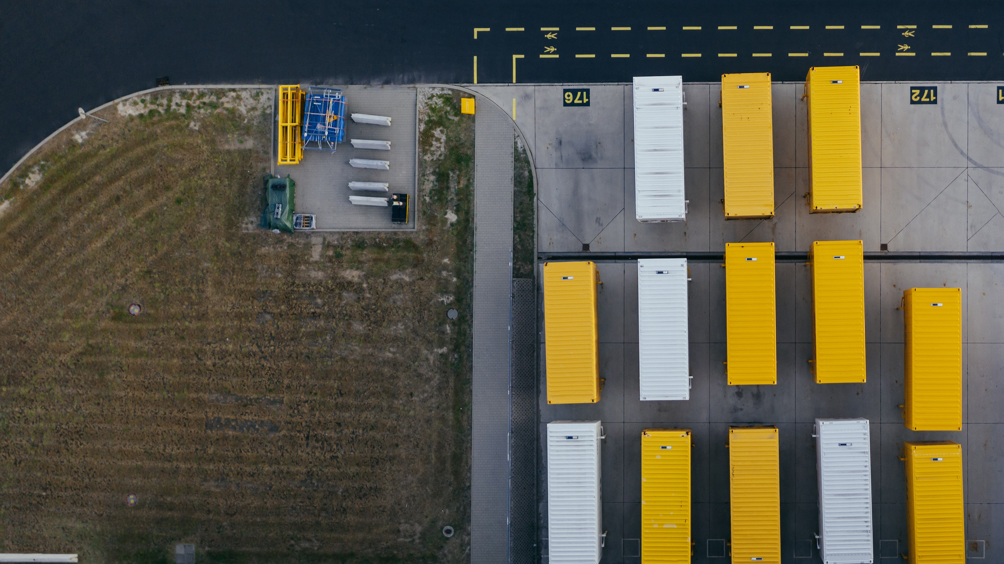
Export
Promotion
Office
of Ukraine
State Institution under
the Ministry of Development of Economy, Trade and Agriculture
Trade promotion
activities
About EPO Activities

Slide 21



Mission of
the Export
Promotion
Office
EPO mission is to help
Ukrainian business to
become successful on the international markets by:
Developing
export
competencies
Facilitating partnership and cooperation
with foreign businesses
Promoting
Ukrainian
products and
services abroad
About EPO Activities

Slide 22





Sourcing Services
Sourcing benefits
Sourcing challenges
in Ukraine
for foreign importers:
Cost
reduction
Time and money consuming
Value
creation
Cross cultural communication problems
Innovation
Sourcing
services of EPO
Best Solution – professional Sourcing Services offered by the Export Promotion Office of Ukraine

Slide 23


Best Solution
to Source in Ukraine
- Export Promotion Office
Our Team offers
Professional Turnkey
Search Services for foreign companies to help them
find Reliable Suppliers of:
Goods
Components
Subcomponents
Services
Technology Solutions
in Ukraine.
Introduction to
Quality Suppliers
B2B meetings
with shortlisted companies
Sourcing
services of EPO

Slide 24





Best Solution
to Source in Ukraine
- Export Promotion Office
Status and
reputation of a government agency
Professional consulting
Team
Access to the databases of reliable suppliers
Able to communicate Western customers’ expectations through
the supply chain
Free of Charge
Sourcing
services of EPO

Slide 25
1
2
How Sourcing with EPO works
Customer’s request to EPO
EPO
sourcing
offer
when looking for new partner in Ukraine
3
4
Kick-off teleconference
Search of quality suitable suppliers
to discuss the Customer’s needs in details
long-list, short-list, reference check
5
B2B
meetings
arranged with shortlisted companies
Sourcing
services of EPO

Slide 26




Our Team
is your contact point
to import from Ukraine
Introduction
to Ukrainian
quality suppliers
Assistance
with local
sourcing
Organisation of buyers’ visits & B2B meetings
On-line services
“Your Ukrainian Supplier”
Sourcing
services of EPO

Slide 27
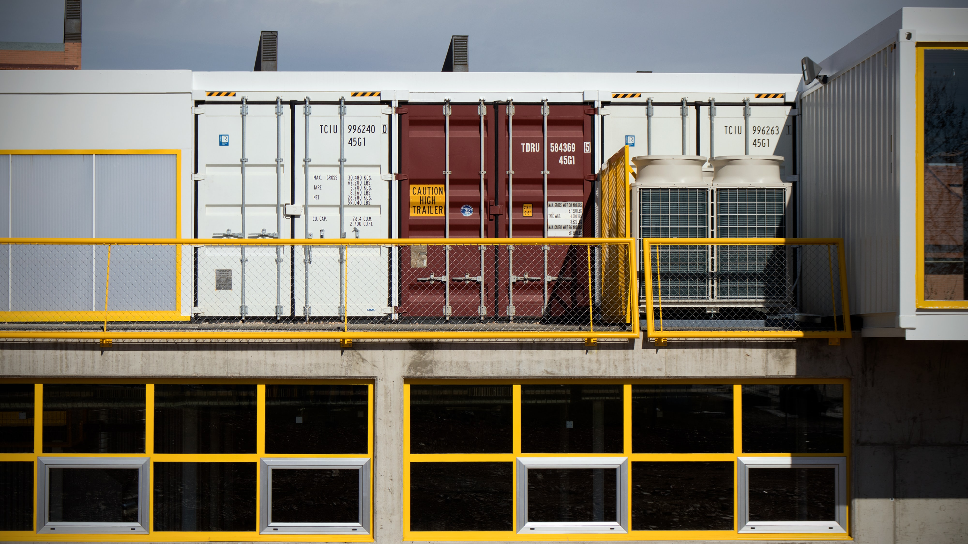
1
Our Team
is your contact point
to import from Ukraine
Send us your supply enquiries
2
We source them
3
We reply you for free
Sourcing
services of EPO

Slide 28







Featured Clients whom we helped to find reliable manufacturers in Ukraine
Falke Ag, Germany
Next PLS, Great Britain
Sanders, Denmark
Dale of Norway
AS, Norway
Decathlon, France
Hitachi Europe GmbH, Japan
Sun Global Corporation, Japan
Naaman Refractories, Israel
Gulf Waves Food Stuff Trading, UAE
Sourcing
services of EPO

Slide 29

Email:
vliashenko@epo.org.ua
facebook
/exportpromotionoffice

